Slide 1


Testing a React App with React Testing Library (RTL)

Slide 2

Agenda
Dependencies needed
Types of tests that can be performed on React Components
Demo of those methods

Slide 3
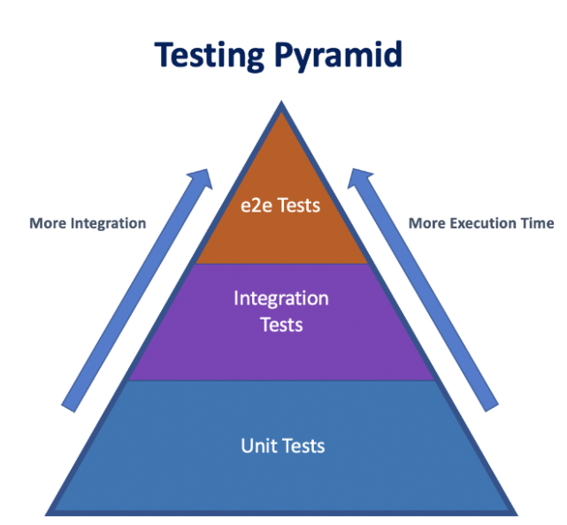
Types of Tests
Payments
Signups
API endpoints
Routes
Cookies
Sessions
Cypress
Puppeteer
React Testing Library + Jest
Enzyme
React-test-renderer
React-dom utilities
👉
Notes:
tools oriented to testing how the real browser renders the whole app Testing the components

Slide 4
Two approaches to testing in React
1) Recreating a browser environment (DOM) and querying for it
👉 React Testing Library + Jest
2) Rendering component trees (instances of components, saved as JavaScript Objects or JSON) and comparing them
👉 React Test Renderer
👉 Snapshot testing
Lastly:
You are responsible for testing your own code.
Writing your own tests is pretty much a requirement nowadays.
Notes:
E2e, time, similiarity

Slide 5
Having said that
React documentation is based on React Test Renderer. This package provides a React Renderer that can be used to render React components to pure JavaScript objects, without depending on the DOM or a native mobile environment.
Create React App recommends React Testing Library if you’d like to test components in isolation from the child components they render.
Some will prefer the React Test Renderer Approach due to its lightweight and speed.
Others would prefer to mockup a browser, due to more similarity to a user behaviour.
Others will prefer to build a real DOM.
Notes:
Essentially, this package makes it easy to grab a snapshot of the platform view hierarchy (similar to a DOM tree) rendered by a React DOM or React Native component without using a browser or jsdom.

Slide 6
Recap - Jest
You know so far how to create tests with Jest. As you have realised by now, Jest is very simple, quick to write, unit testing tool and test runner.
Basically, writing a test in Jest is as simple as:
expect(call_a_function(...params)).not?.someMatcher(expected_result)
But what about a whole component?
And its interaction with other elements?
That is where React Testing Library comes handy.

Slide 7
React Testing Library
Guiding Principles
The more your tests resemble the way your software is used, the more confidence they can give you.
TL,DR:
If it relates to rendering components, then it should deal with DOM nodes rather than component instances (aka not objects or JSONS)
It should be generally useful for testing the application components in the way the user would use it.
Utility implementations and APIs should be simple and flexible (aka mocking)
We want is for this library to be pretty light-weight, simple, and understandable.

Slide 8
AAA Pattern
Arrange
Act
Assert
Arrange: Set up your testing environment (render the component). Create, mock.
Act: Trigger changes, fire events.
Assert: Check whether the expectations were met.
render + act + assert

Slide 9
React Testing Library
Built on top of DOM testing library:
Tests DOM nodes
Queries the DOM for nodes (get an element which ID is <some_id>, get an element whose text is <some_text>)
Allows to fire events: click, onsubmit.
Allows to await for async actions with a wrapper method waitFor()
Provides a screen object which has all the queries pre-bound to document.body as the main container.
Testing Library is not a test runner, so you will need another tool to run the tests (like Jest for example)
Adds APIs for working with React components:
Render method, which returns an object with several properties (all the queries from DOM testing library, plus other methods like unmount and rerender)
Cleanup, which unmounts a React tree mounted with Render
Act, which actually wraps the act method from react-dom/react-utils. Prepares a component for assertions

Slide 10
DOM Testing Library
The query system is based on Variants. Here we have 3 of them:
getBy: First matching node for a query.
Throws an error if no matches.
Throws an error if several found.
queryBy: First matching node for a query.
Returns null if no matches.
Throws error if several found.
findBy: Async. Returns a promise which resolves when an element is found.
Rejected if no element found
Rejected if several found
TL;DR: All methods will throw an error/reject if they found more than one match.
👉 Probably, you will be using getBy most of the situations.

Slide 11
DOM Testing Library
getAllBy: Array of matching nodes for a query.
Throws an error if no matches.
queryAllBy: Array of matching nodes for a query.
Returns empty array if no matches.
findAllBy: Async. Returns a promise which resolves to an array of elements.
Rejected if no elements found
TL;DR: 👉 Probably, you will be using getAllBy most of the situations.

Slide 12
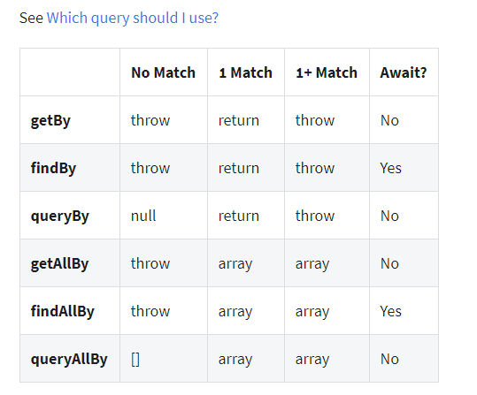
DOM Testing Library

Slide 13
DOM Testing Library
Creating a query Formula:
get/query/find + all? + By + query
Queries:
ByLabelText
ByPlaceholderText
ByText
ByAltText
ByTitle
ByDisplayValue
ByRole
ByTestId
👈
👈
👈
👈

Slide 14
DOM Testing Library
So far, with DOM Testing Library, we have the capability of grabbing DOM elements.
We can also trigger events on those elements.
The next thing we would like to do, is to compare to a matcher.
Let’s see some extended matchers that testing-library/jest-dom provides

Slide 15
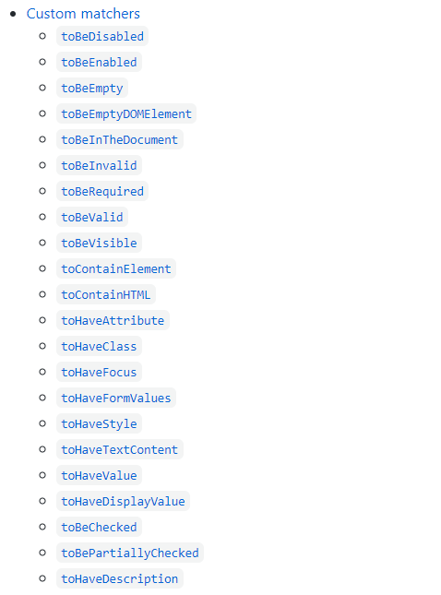
Jest-dom matchers
https://github.com/testing-library/jest-dom
Extends matchers to the ones provided by Jest.
In addition to the ones provided by Jest, it provides matchers related to DOM elements: .toHaveTextContent, .toBeInTheDocument

Slide 16
Basic Setup
EXAMPLES 🤩

Slide 17
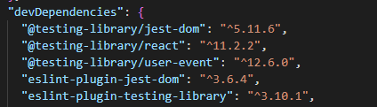
Basic Setup - CRA
What we need in addition to Jest and react-scripts:
yarn add --dev @testing-library/jest-dom // for extended matchers
@testing-library/user-event// for creating events
@testing-library/react // querying, rendering components
eslint-plugin-jest-dom // linter, suggests methods
eslint-plugin-testing-library // linter, suggests methods
After adding the dependencies, they should be visible in package.json

Slide 18
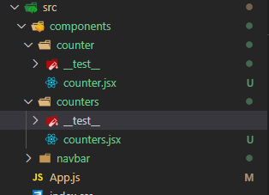
Basic Setup
Basic template: note the __test__ folder which will hold the test file
Each component will have its own folder with its CSS (or SASS) module, as well as a folder __test__. Inside __test__, we will have a file named the same way as the component but with the .test.js suffix.

Slide 19
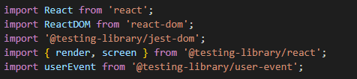
Basic Testing - Boilerplate
We Will need to bring some functionalities from those scripts. Among them:
testing-library/jest-dom: Basically the extended matchers.
ReactDOM: Mounts a component
render from testing-library/react. Renders a component.
Screen from testing-library/react. Object with all the queries pre bonded.

Slide 20
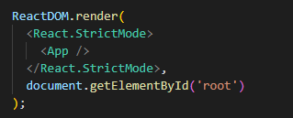
Basic Testing - Boilerplate
Left: imports, Right: index.js of Create React App
ReactDom.render(): It is the function that bootstraps our app into an html element. It is used in index.js of Create React App. Attaches a component to a node. We will use it to attach an instance of our component to a controlled node that we will create.
Notes:
Live code create react app and go to the index.js

Slide 21
Basic Testing - Boilerplate
BoilerPlate
@testing-library/react.render(): Takes any JSX to render it. Afterward, you should have access to the React component in your test.

Slide 22
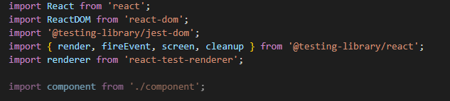
Basic Testing - Boilerplate
Left: imports, Right: index.js of Create React App
@testing-library/react.render(): Takes any JSX to render it. Afterward, you should have access to the React component in your test.
@testing-library/jest-dom: Allows to use more matchers to check what we need to. Among them, if the element is present in the document, if it is empty, if it is visible, if it contains a specific class, if it is valid, if it contains certain text, etc.

Slide 23
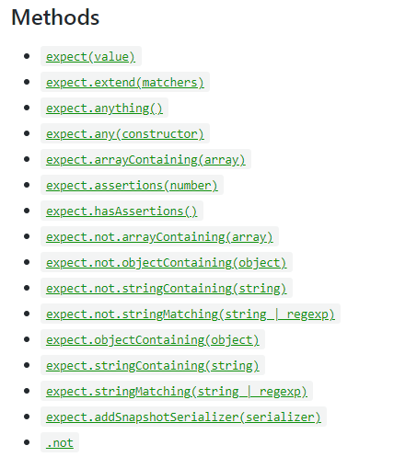
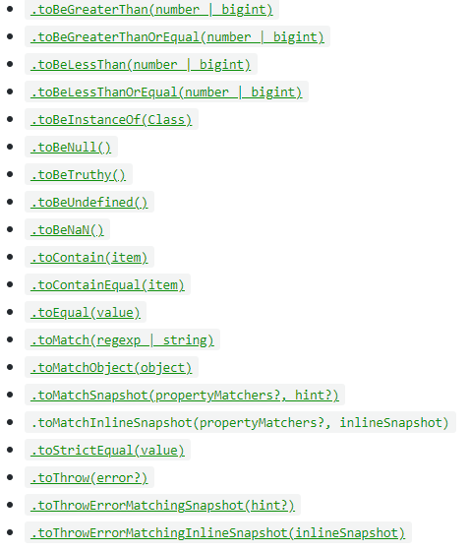
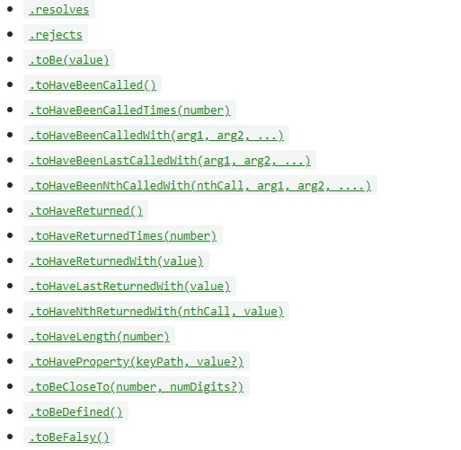
Basic Testing - Boilerplate
Expect
When you're writing tests, you often need to check that values meet certain conditions. expect gives you access to a number of "matchers" that let you validate different things.

Slide 24
Basic Testing - React App
We are going to write tests for the following app:
https://github.com/israeltechchallenge/counter-for-testing
Take 5-10 minutes to download the code, read it and be familiar with it.
Send a 👍 on the chat when you are done.

Slide 25


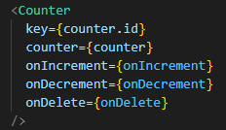
Basic Testing
Let’s say we have a Counter component that looks like this upon start:
And this way when the plus has been pressed X amount of times
And expects these properties:
key: because it has been generated with .map
counter: {value: <number>, id:<number>}
onIncrement, onDecrement, onDelete: callbacks

Slide 26
Basic Testing
#1
Our First test should always check that the component doesn’t crash our app.
Crashes might happen when a component is expecting some props, and it doesn’t receive them, when there are infinite loops re rendering the component…
Long story short, let’s give it a look.

Slide 27
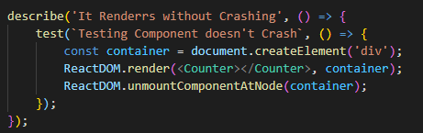
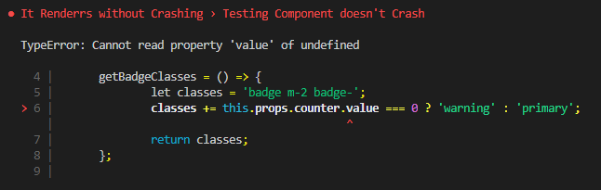
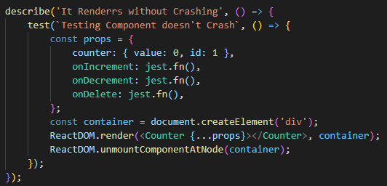
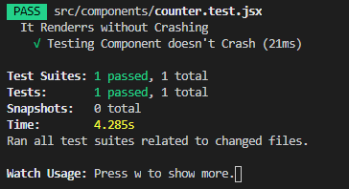
Basic Testing
First thing to check: that the component mounts properly.
Now again with props:

Slide 28
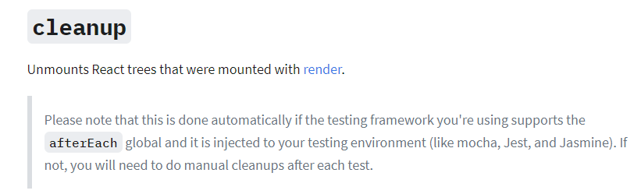

Basic Testing
#2: Always Cleanup. Cleaning up means to reset a mounted component, clear a node element where you are attaching it. If you need to cleanup more operations, add them.
Good news: Part of it happens automatically on Jest.
This used to be an often practice, not necessary anymore.

Slide 29
Basic Testing
#3 - AAA
Now we can start testing the component. What should we test?
We should test that clicking on the plus, the number goes up by one and the background gets blue.
Same for the minus
We should test that the delete button triggers a callback (the actual function will be tested on the component where it lives)
We should test that given zero, displays ‘Zero’ with yellow background
Note: we know that each button should trigger a callback to the parent. In this component, we only care about that, that triggers a callback. On the parent, we will need to deal with the real functionality

Slide 30
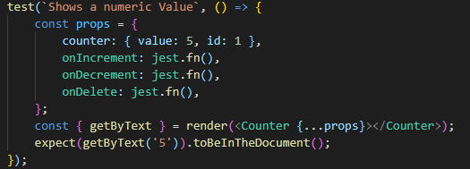
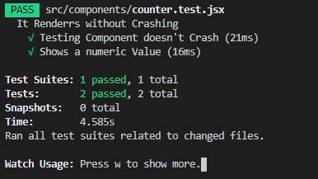
Basic Testing - getByText
Once we render a component with testing-library.render() we have access to all the queries available from DOM Testing Library. Let’s give a look to the queries:
https://testing-library.com/docs/dom-testing-library/api-queries
As seen in the above test, we are using getByText. Let’s use a different one, in this time, getByTestId.

Slide 31
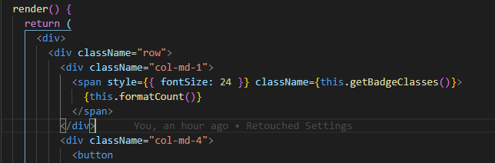
Basic Testing - getByTestId
getByTestId requires that we add a property to the node that we want to test, inside the component:

Slide 32
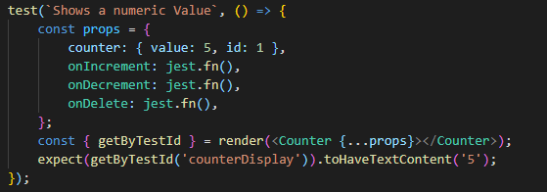
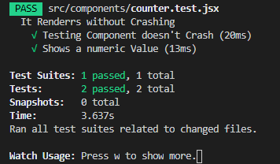
Basic Testing

Slide 33
Basic Testing
So far, to test this component we have used the following queries:
getByText
getByTestId
And the following matchers:
toBeInTheDocument
toHaveTextContent
More queries: https://testing-library.com/docs/dom-testing-library/api-queries/
More matchers: https://github.com/testing-library/jest-dom

Slide 34
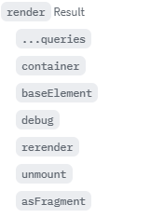
Basic Testing
You have seen that we extracted getByText as well as getByTestid from rendering a component:
We can also extract more elements from the render:
All the queries mentioned before
container: Since the container of the rendered component is a div, we can extract the container from render and perform selectors like .querySelector, .queryAll. Better to use the queries from the DOM testing library.
baseElement: Defaults to the DOM node where your component is rendered. If this option is not supplied, defaults to document.body. What is it useful for? If your component renders something outside its container.
debug: For debugging. Console.logs the element. Better to use screen.debug()
rerender: we can rerender the same component with new props.
unmount: Unmounts the component
asFragment: useful to compare diffs on Snapshots

Slide 35
Basic Testing - getByTestId
Let’s test a button now.
The increment button should trigger this.props.onIncrement()
In order to trigger an event, we need to search for the element that should trigger it on our rendered component, intentionally launch that event, and then compare the result expected.
Using jest.fn() we can mock up the real functions and replace them by a Jest one to check how many times has it been called, with which parameters, etc. We are abstracting from implementation details.
Let’s give it a look:

Slide 36
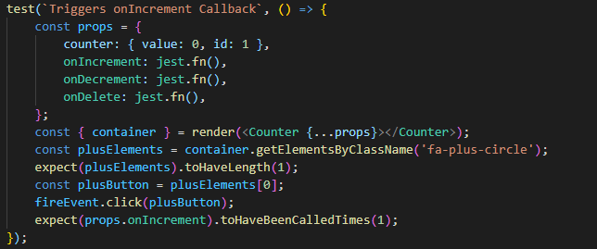
Basic Testing - Firing an event
As seen on the previous slides, we can extract the container where the component has been rendered and perform also HTML DOM queries. Even tough is possible, They're an implementation detail and react-testing-library specifically chooses not to use them as an identifier for DOM elements.
Better to use a testid or grab them by a more specific selector. In button cases, we can use getByRole(‘button’, {}) and pass an object as second parameter with the properties we are looking for.

Slide 37
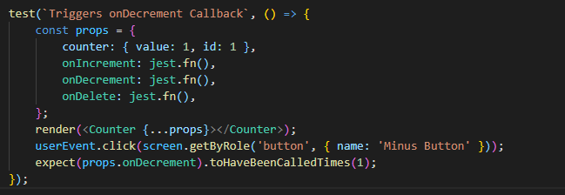
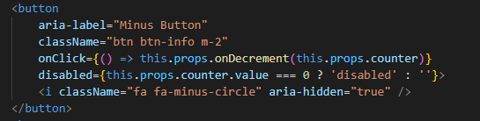
Basic Testing - Firing an event
Have a look to this link for best practices / common mistakes: here. Created by the testing Library author.
Try to grab the element using screen
Try to grab the elements by the way a user would. Instead of grabbing it by Id, or by classname, let’s assign an aria-label attribute. That’s the way a reader would.

Slide 38
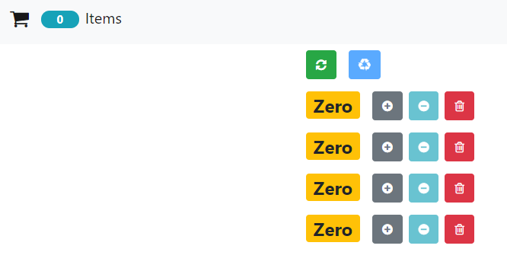
Basic Testing a MidComponent
On our counter app, we have tested the minimum component which is counter.js. Counters.jsx renders several components of counter.js.
You shouldn't check if your child component is rendered or not, because it's testing implementation details (which testing library doesn't encourage you to do).

Slide 39
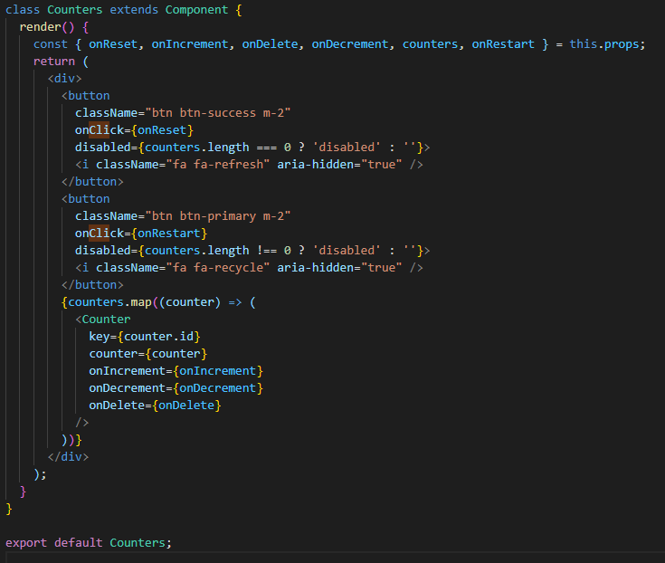
Basic Testing a MidComponent
In React Testing Library, we don’t check implementation details.
The fact that it renders a child, it is an implementation detail. We shouldn’t check the child properties in these tests.
But we can check that it renders the right amount of counters.
How? We mock up the whole counter component!

Slide 40
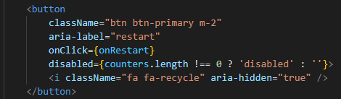
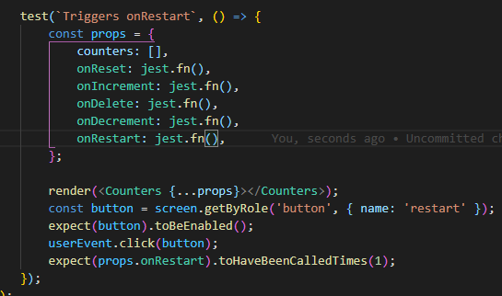
Basic Testing a MidComponent
When testing for buttons, make sure before triggering the click event that the button is enabled. In this case, if the props.counters doesn’t have a length, it will be disabled. We need to make sure to replicate that condition in the test, to test that the button works properly.

Slide 41

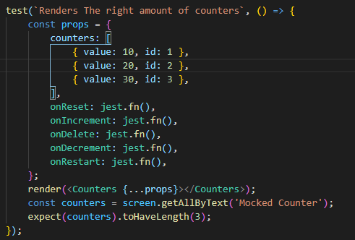
What happens with childs?
Jest.mock should be placed outside the describe. The path to the module should be relative to the test file.
Since child components should be tested separately, we actually don’t care about how them are being rendered in the counter component.
But, we do care we have the right amount. To abstract from errors that could happen on counter.js, we can mock up that module.

Slide 42
Top level component
Since most of the functionality of the this app remained on the App component, that is where we will have most of the testing.
The good thing about RTL (React Testing Library) is that asserts for behaviour. That means, that you don’t need to check for each function in the class. If you want, you can do that with Jest. You check for behaviour. So, a reasonable test would be something like:
“Check that the display of the second counter has the written string: ‘Zero’. Then, click on the + of the second counter. Check that the display of the second counter has a value of 1”.
We are not checking if this.handleIncrement() was launched, the callbacks or context.

Slide 43
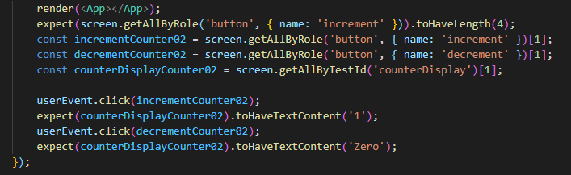
Top level component
Question: What is this test trying to perform?
Answer: Counter gets updated on increment and decrement.

Slide 44
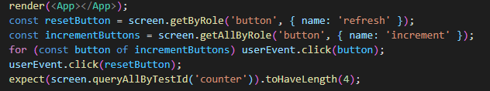
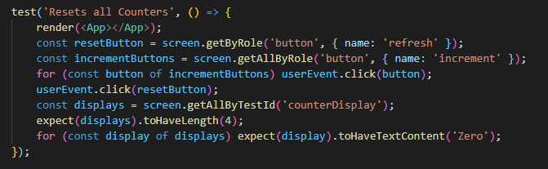
Top level component
Question: What is this test trying to perform?
Answer: Nothing. What it is doing is grabbing all the increment buttons, clicking them. Afterwards, the assertion checks for the amount of counters, which hasn’t changed.
How would you fix it?

Slide 45
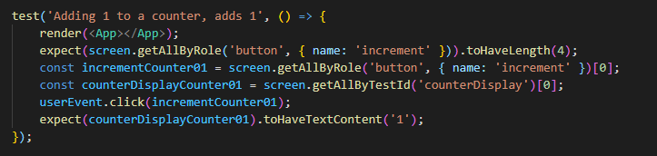
Top level component
Question: What is this test trying to perform?

Slide 46
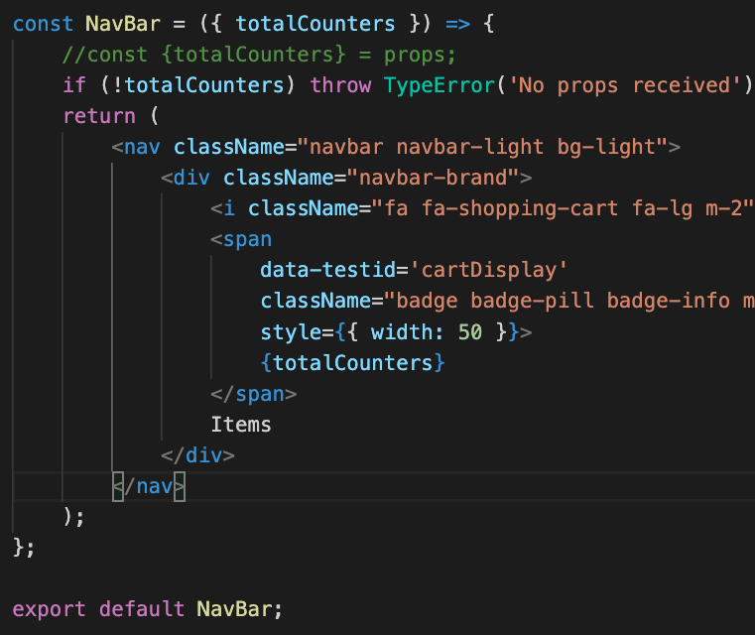
Testing for errors
The functional component NavBar throws an error if totalCounters is falsy, not mounting the component and crashing the app.
Stating that this is the desired behaviour, how can we test that the component throws an error in RTL?
Answer: Pretty much the same as how it was done on Jest. You wrap the element that you expect it to throw inside a function. Let’s give it a look

Slide 47
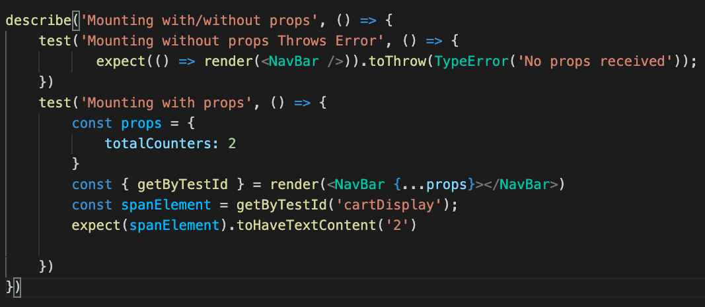

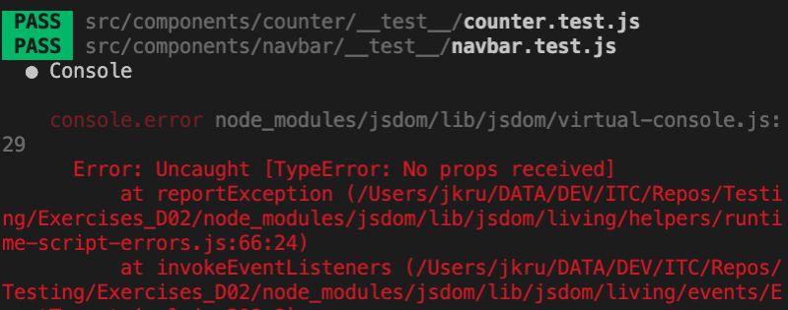
Testing for errors
The test suite passes.
But it shows a log with the error (image below).
To silence the console, we can add the --silent flag to our jest script in package.json:

Slide 48
Recapping React Testing Library
Don’t test for React behaviour (passing props, state).
Test for user behaviour and expectations.
Don’t worry about components deeper than one level.
Abstract (mock) elements that are not part from the within component (modules, child components)
Follow a behaviour driven pattern for writing your tests the same way a user would.

Slide 49
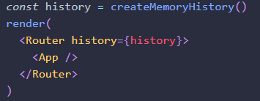
What about routes?
React Testing Library has good compatibility with React-router.
In both packages the documentation points one to the other.
The idea behind testing routes is:
On your test file, when rendering the component, wrap it on a Router component with a history property, and pass a createMemoryHistory() to it:
Grab a button that redirects (for example, about)
Fire Event (click for example)
expect that the screen object matches the content of the new route.

Slide 50
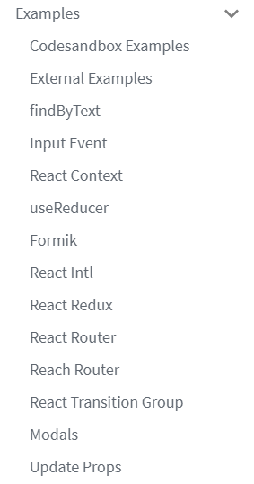
Specific Examples
https://testing-library.com/docs/recipes
Also recommended to read:
https://kentcdodds.com/blog/common-mistakes-with-react-testing-library
Another site with good examples:
https://react-testing-examples.com/

